Slide 1
CRM ANALYTICS

Slide 2
Names of Group Members
Pooja Vijaywargi
Nima Sangmo
Prasad Swamy
Ajith Kumar

Slide 3
Topics Covered
Introduction
Lead and opportunity dashboard
Challenges faced

Slide 4
Introduction
CRM (customer relationship management) analytics comprises all of the programming that analyzes data about customers and presents it to an organization to help facilitate and streamline better business decisions.

Slide 5
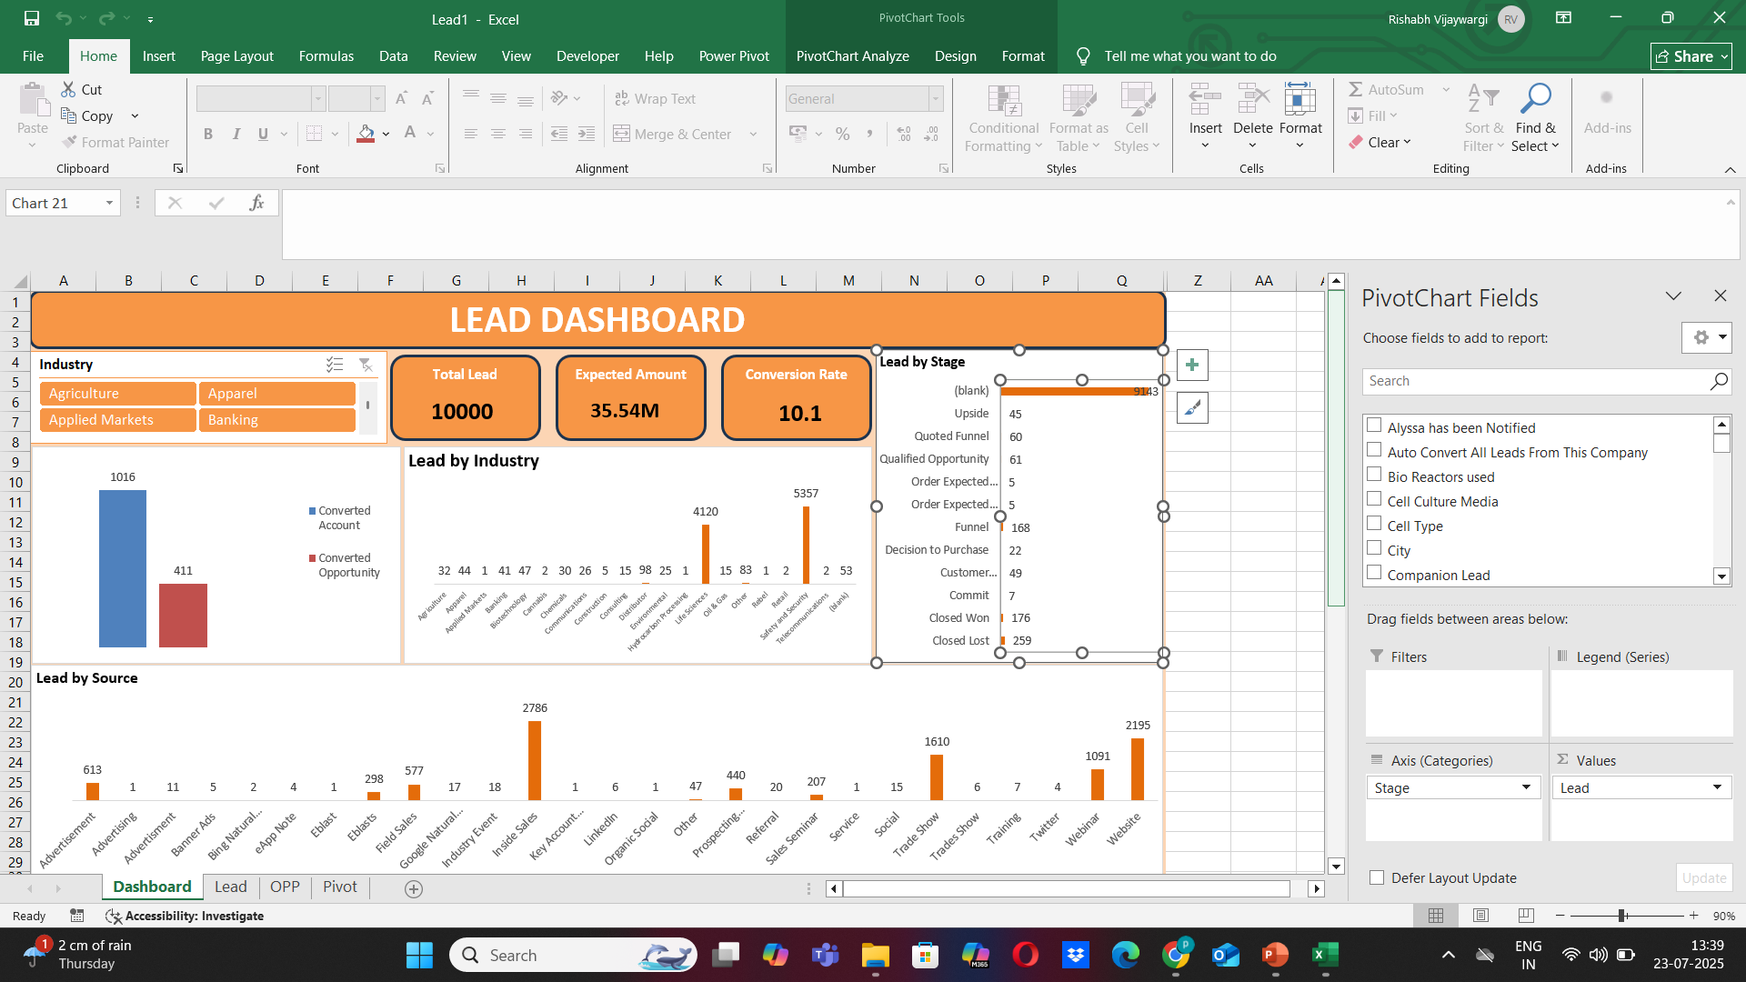
Lead Dashboard of Excel

Slide 6
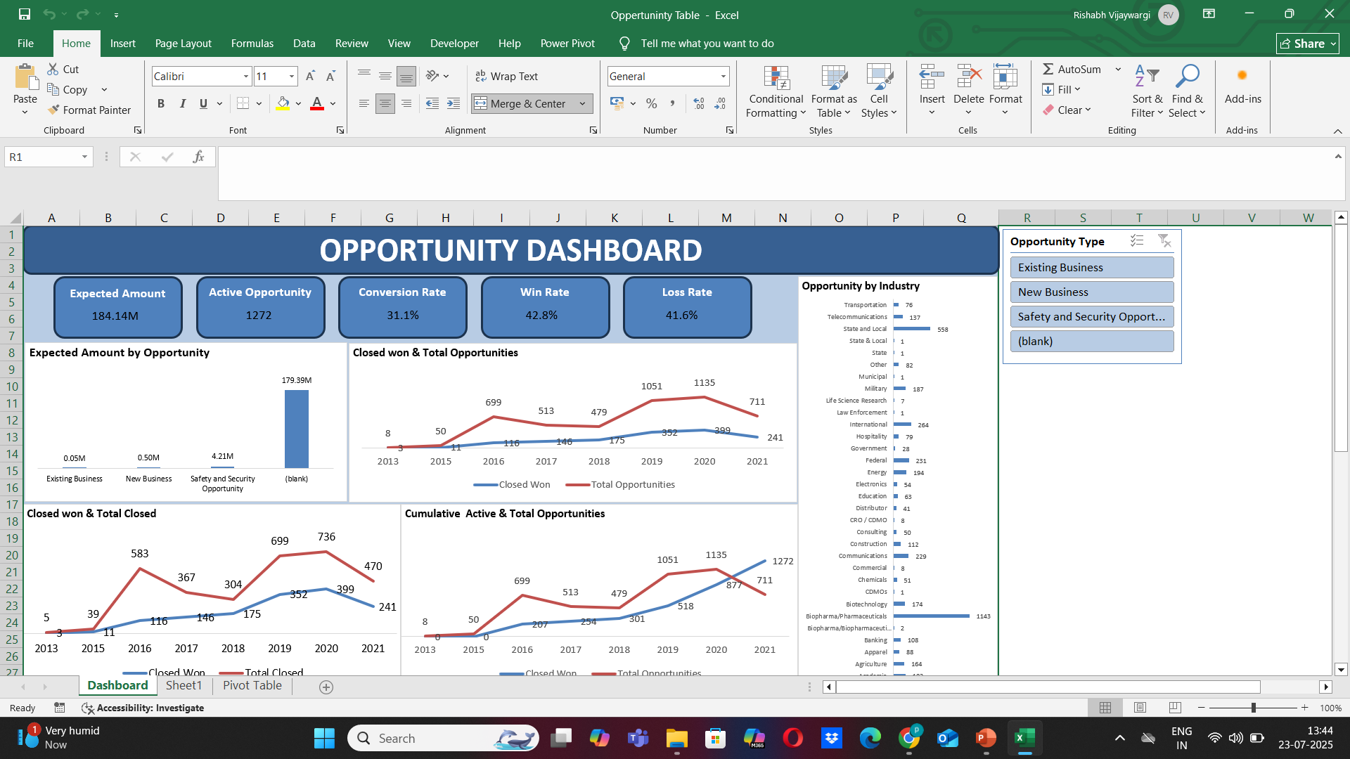
Opportunity Dashboard of Excel

Slide 7
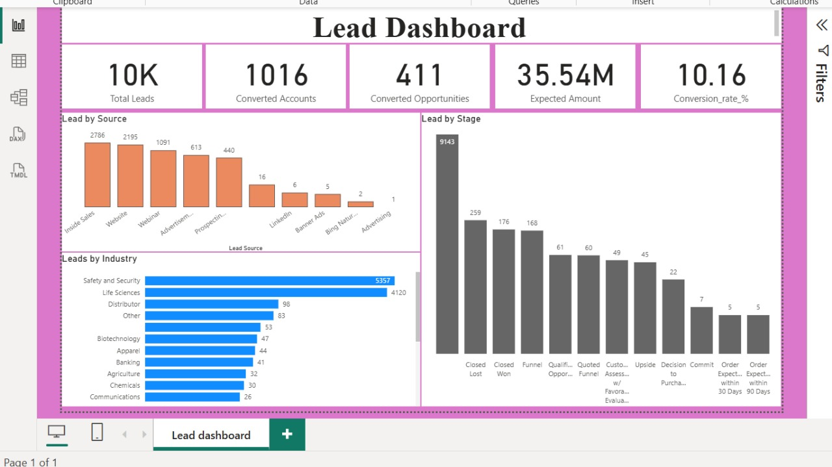
Lead Dashboard of Power BI

Slide 8
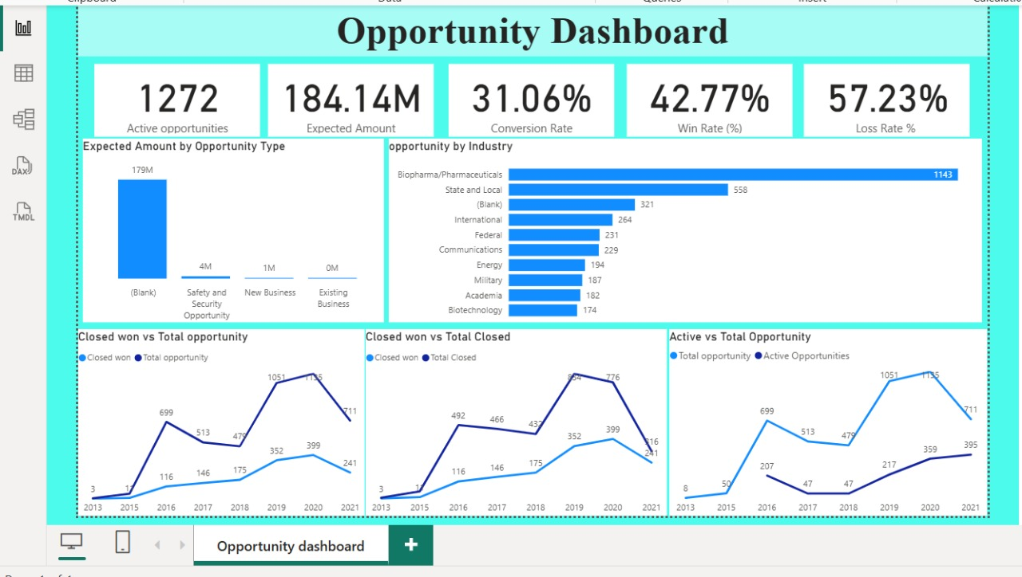
Opportunity Dashboard of Power BI

Slide 9
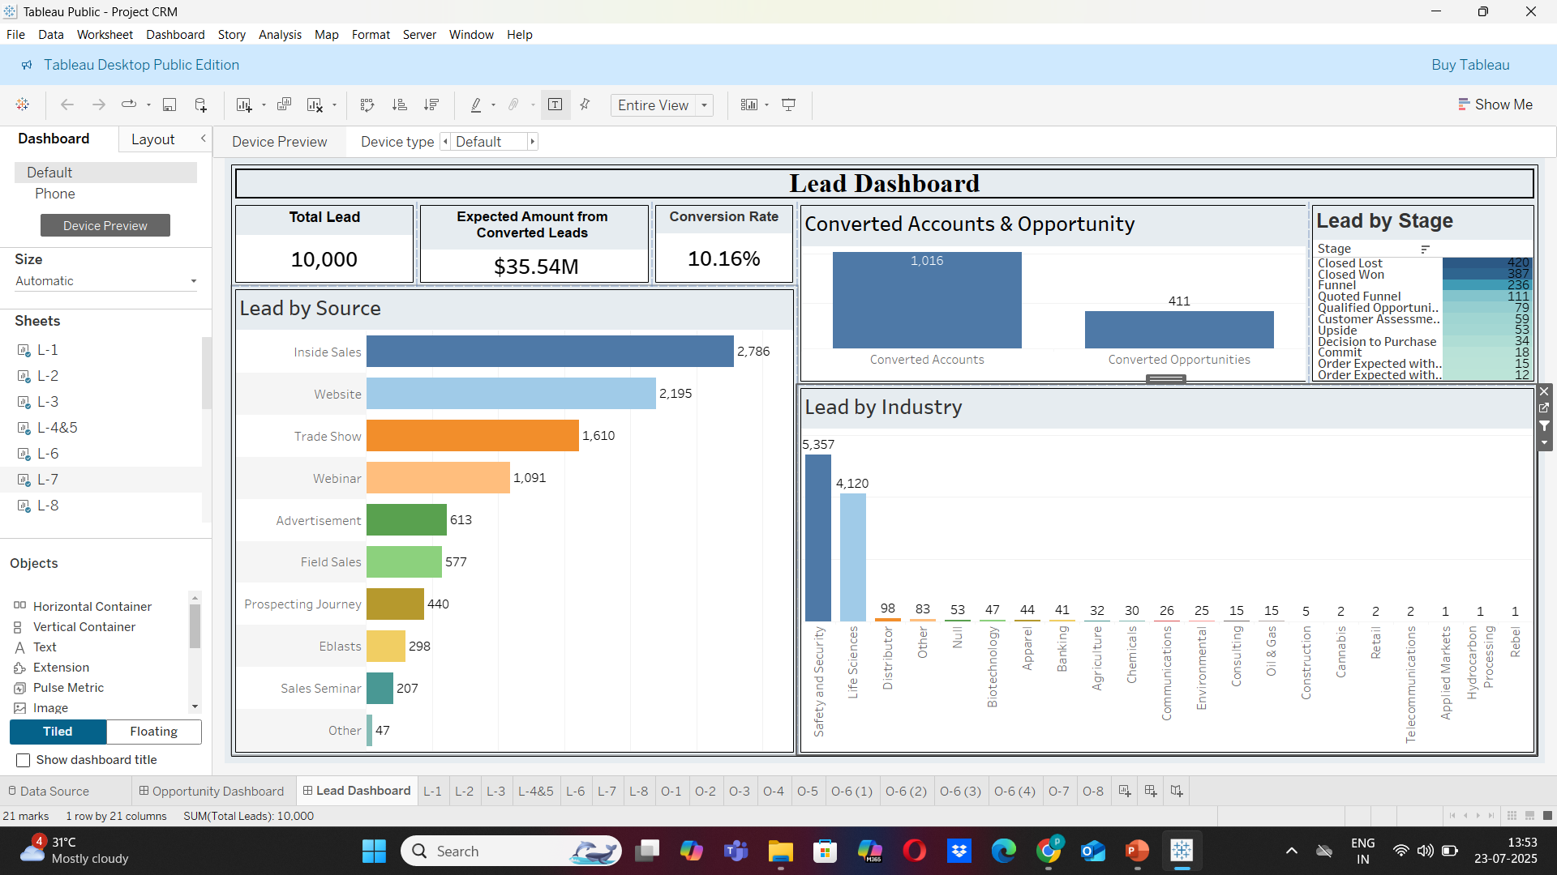
Lead Dashboard of Tableau

Slide 10
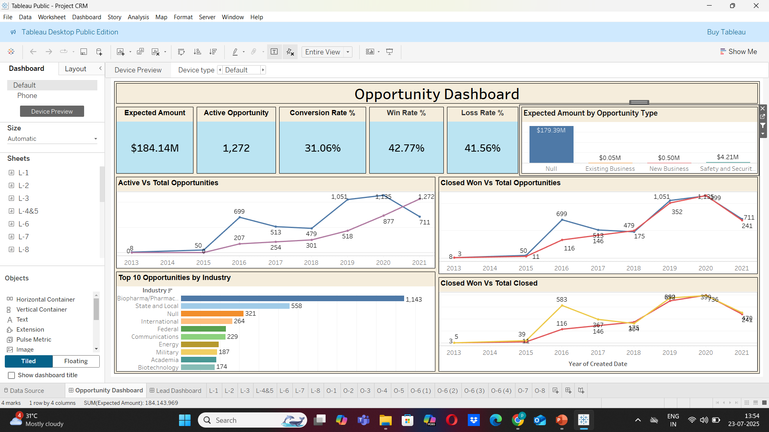
Opportunity Dashboard of Tableau

Slide 11
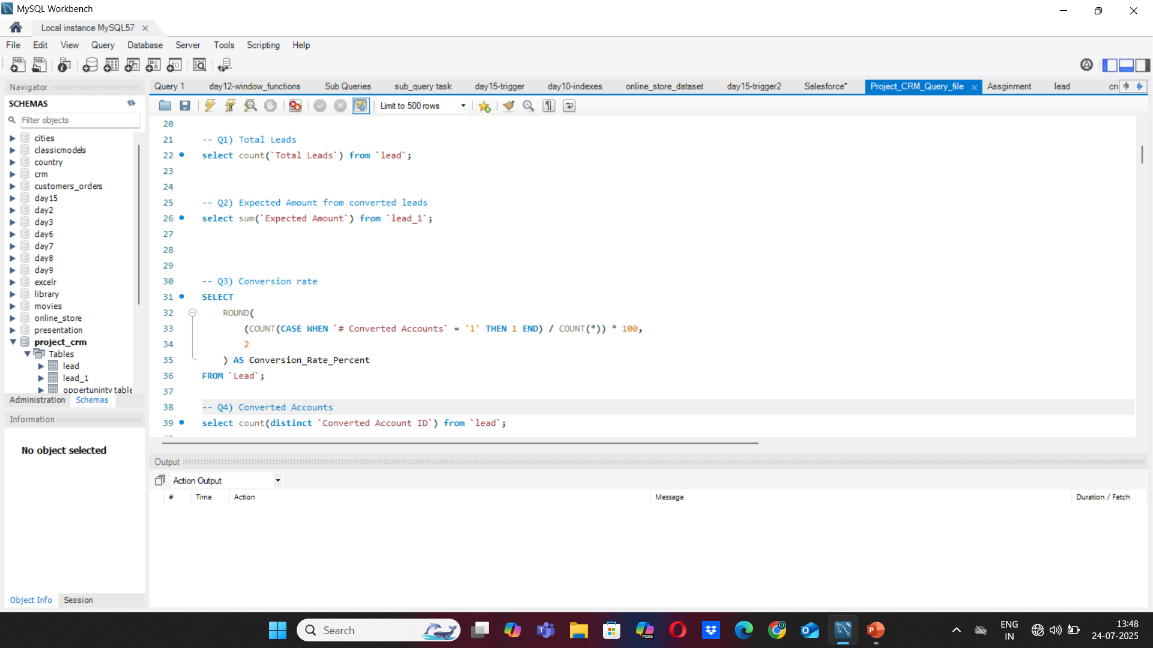
Lead Dashboard of SQL

Slide 12
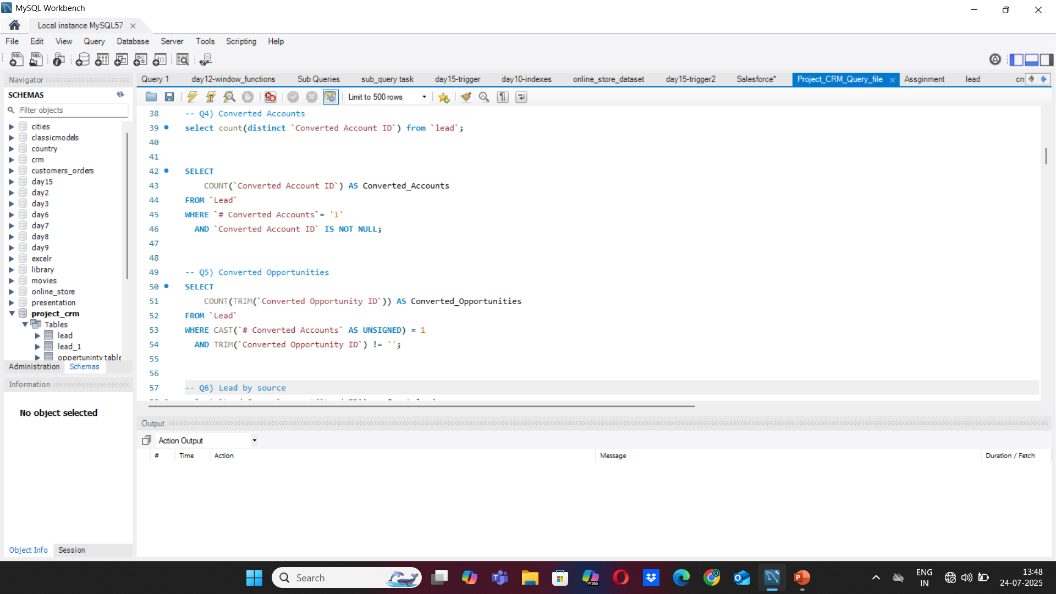
Lead Dashboard of SQL

Slide 13
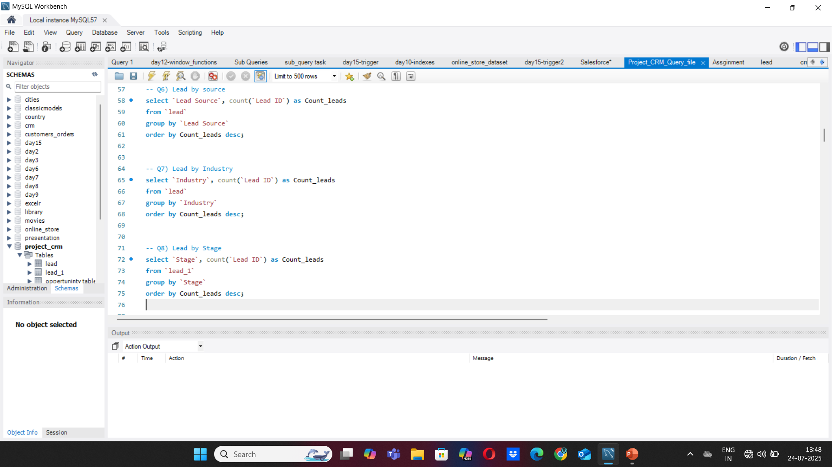
Lead Dashboard of SQL

Slide 14
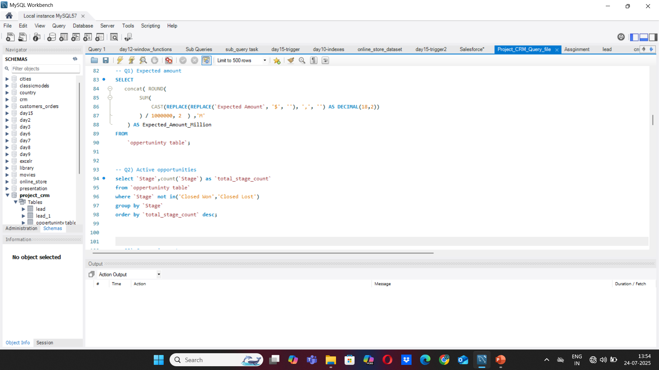
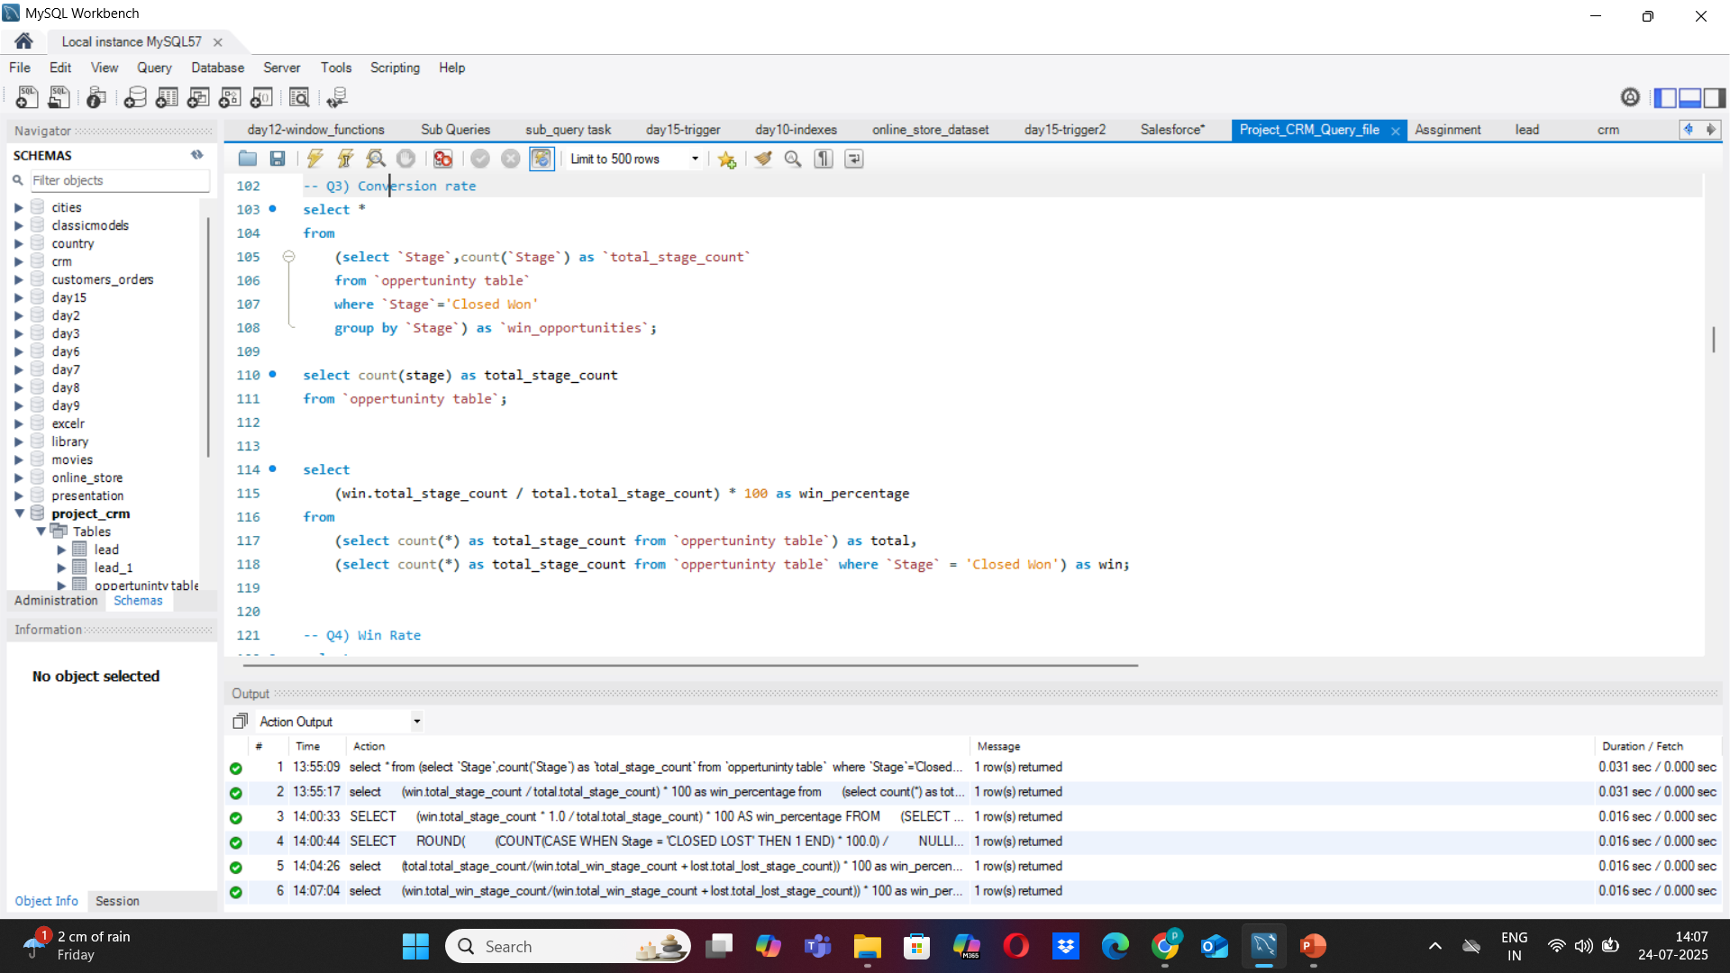
Opportunity Dashboard of SQL

Slide 15
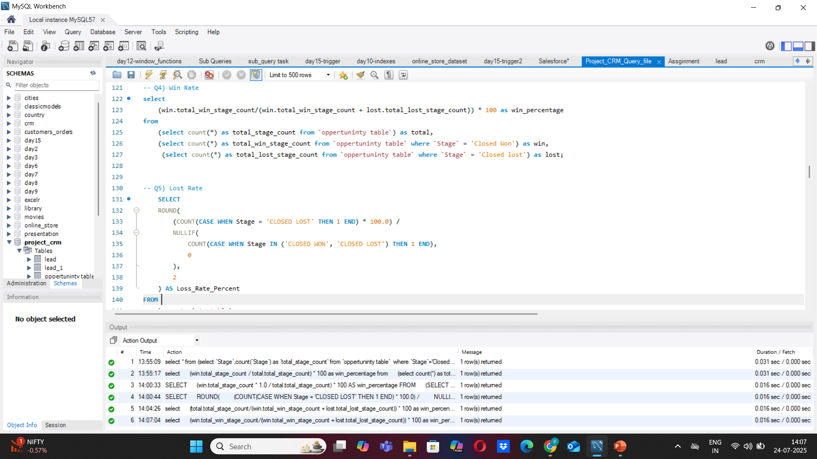
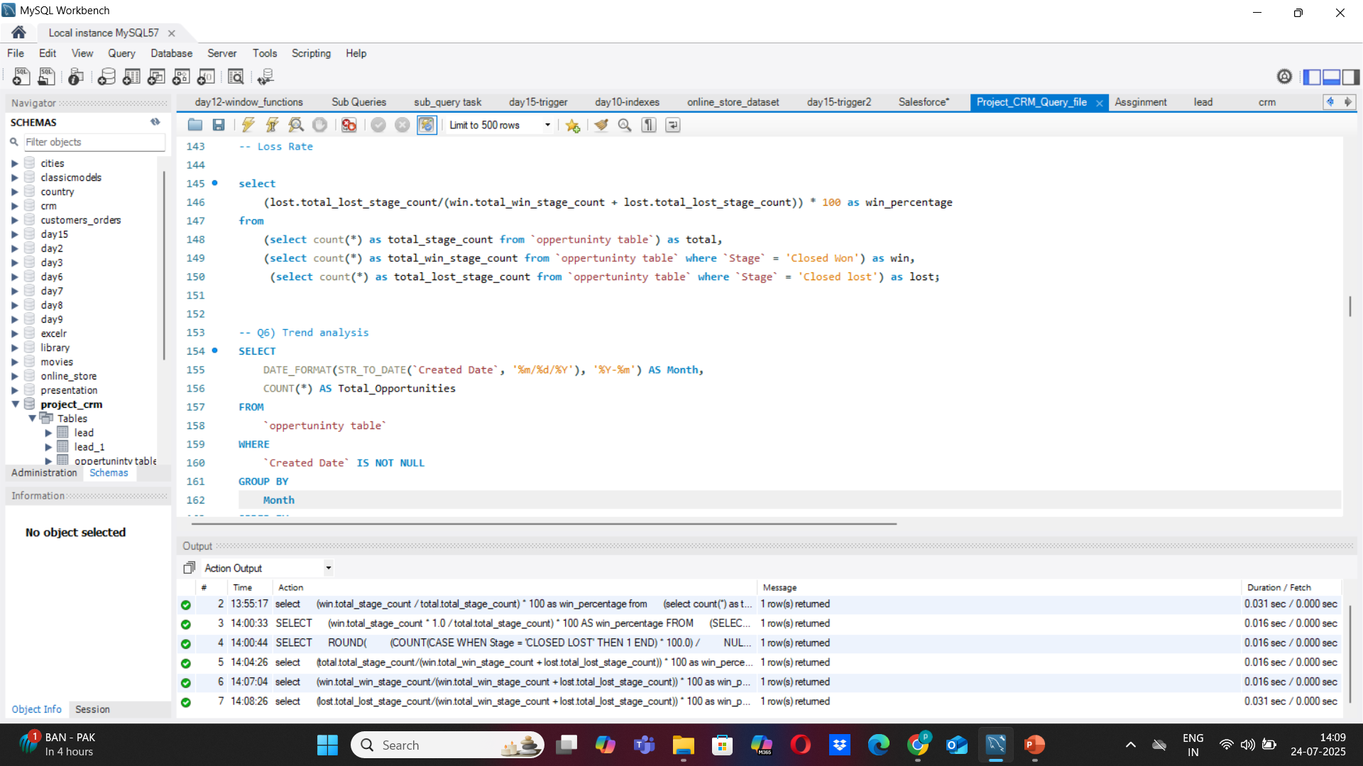
Opportunity Dashboard of SQL

Slide 16
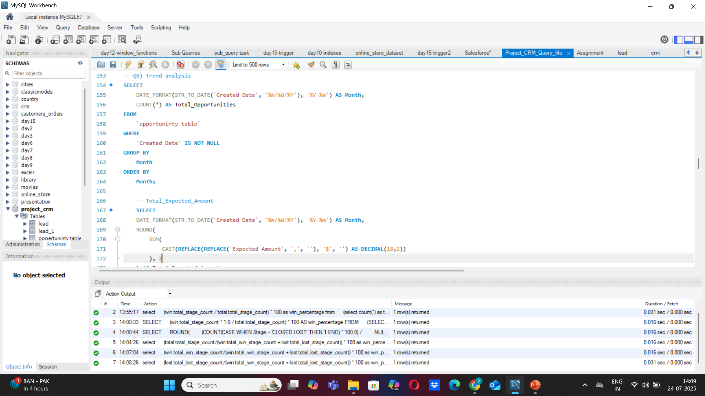
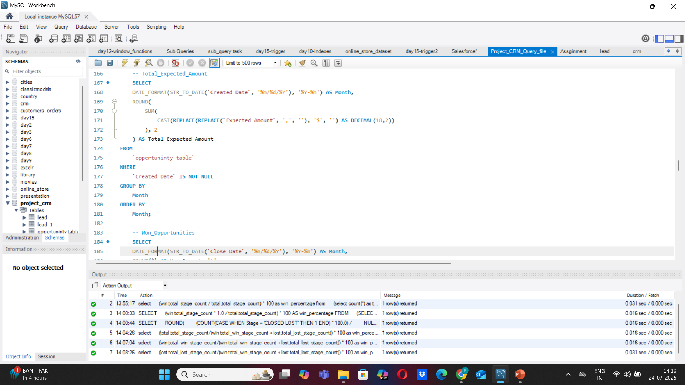
Opportunity Dashboard of SQL

Slide 17


Opportunity Dashboard of SQL

Slide 18
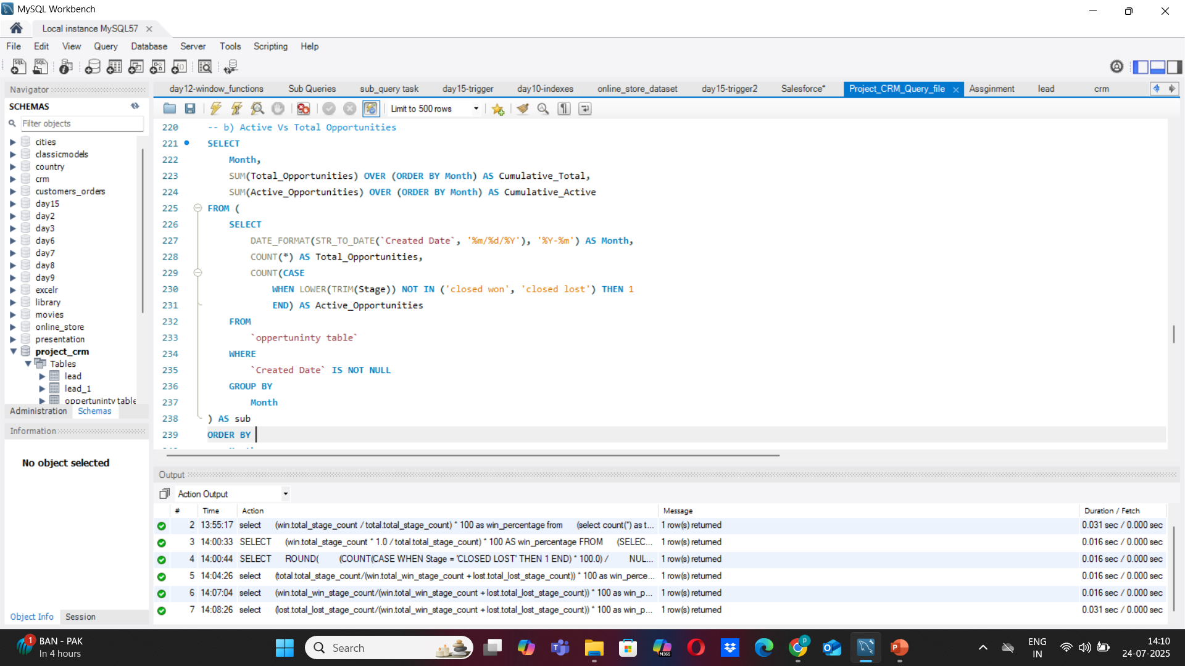

Opportunity Dashboard of SQL

Slide 19
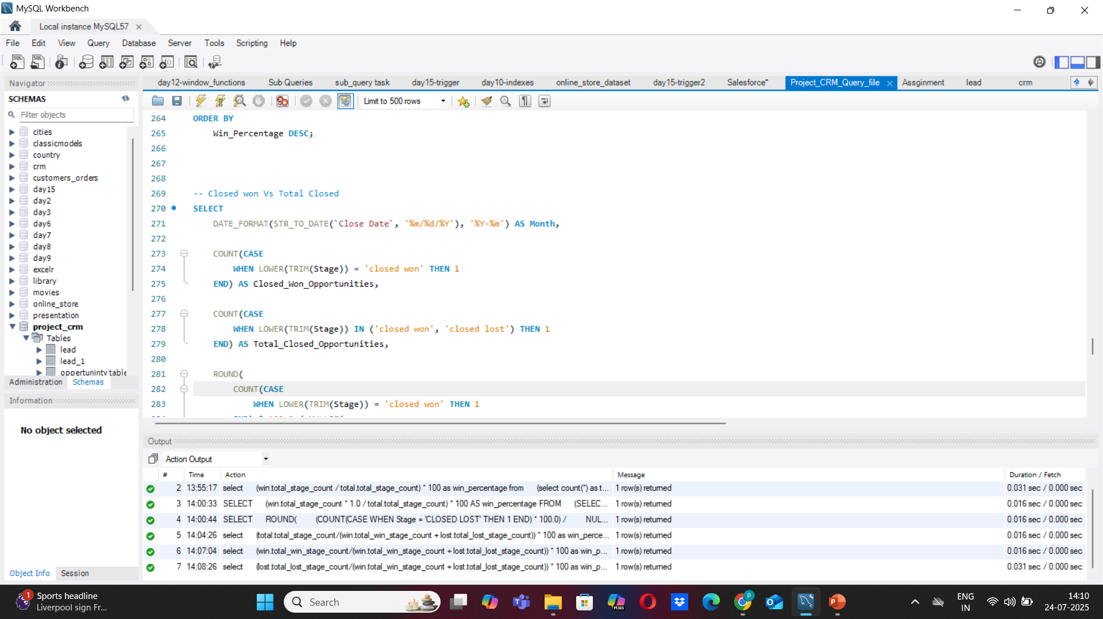

Opportunity Dashboard of SQL

Slide 20
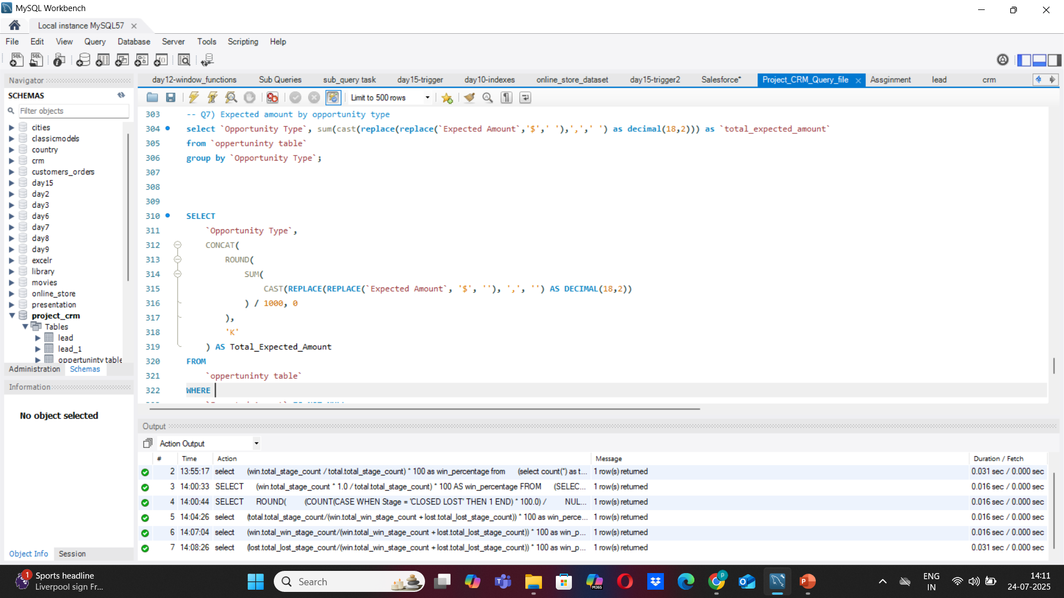

Opportunity Dashboard of SQL

Slide 21

Opportunity Dashboard of SQL

Slide 22
Challenges faced while doing project
Data Cleaning is finding difficult.
Incorrect or inconsistent calculation.
Difficulty in uploading data in SQL.

